Slide 1

TACTILE VR
Practical uses in EFL

Slide 2

Tactile Virtual Reality
Tactile Virtual Reality (TVR) technology is the combination of two technologies—physical elements and digital information or data to form a touch sense in a highly immersive environment of virtuality

Slide 3

FEATures of TVR
This type of virtual technology creates the sense of touch by combining the impact of haptic elements and digital information.
It is the latest technology in the field of virtual reality ecosystem
Advanced artificial intelligence and machine learning technologies such as motion detection, behavior detection, pattern sensing, and others are used in building the virtual reality technology dealing with the touch senses.
The foundation of tactile motion is based on haptic technology, which deals the stimulations that produce the sense of touch.
The haptic devices that produce touch-sense include kinetic components and tactile sensors

Slide 4
FEATures of TVR
The touch senses are created through a tactile simulation with the help of haptic technology, which uses vibration, force feedback, temperature senses, and allied feedbacks to create a tactile virtual reality environment.
The most important use of tactile virtual reality in modern industries is mainly focused on entertainment industry such as gaming and 3D visual entertainment.

Slide 5
Augmented Reality and Virtual Reality
Augmented reality, precisely referred to as AR, and virtual reality, precisely known as VR are two highly emerging technologies in the modern software and information technology-based industries.
The superimposition of computer-generated images, audio, video, or other senses on the existing real-world environments such as images and other contents to improve the quality of the real-world ecosystem is known as augmented reality
The virtual reality (VR) is also a virtual technology in which the real environments can be visualized in the virtual objects such as products used in home renovation, clothing, and many other products.

Slide 6
History and Evolution of Tactile Virtual Reality
1838—Stereoscopic photos and viewers era is dominated by the creation of two dimensional images through stereoscope that would generate a sensational view. The first stereoscope was developed by Charles Wheatstone.
1839—Development of View-Master for virtual tourism by William Gruber.
1849—Creation of lenticular stereoscope by David Brewster.
1929—Creation of “Link Trainer” by Edward Link. It was a commercial airplane training simulator model.
1930—The idea of pair of goggles was enunciated by science fiction writer Stanley Weinbaum in his creation named as Pygmalion’s Spectacles.
1950—The creation of Sensorama by cinematographer Morton Heilig.
1960—The development of Telesphere Mask by Morton Heilig. It was the first head-mounted VR display.

Slide 7
History and Evolution of Tactile Virtual Reality
1961—Development of first motion tracking display named as HeadSight by two engineers named as Bryan and Comeau. 1965—Development of the concept of ultimate display explained by Ivan Sutherland.
1966—Development of Furness Flight Simulator, which is considered as the first modern invention of light simulator. It was invented by Thomas Furness.
1968—Creation of the first AR/VR head mounted display (HMD) named as Sword of Damocles by Ivan Sutherland and his student Bob Sproull.
1969—The emergence of the concept of Artiicial Reality through multiple projects in which the computer generated environments could interact with the people in it. It was developed by Myron Krueger.
1975—Creation of VIDEOPLACE, the irst interactive VR system by Myron Krueger.

Slide 8
History and Evolution of Tactile Virtual Reality
1982—Development of Sayre Gloves by Daniel Sandin.
1987—The term Virtual Reality was coined by Jaron Lanier, founder of Virtual Programming Lab VPL company.
1991—Creation of Medina’s Mars Rover by Antonio Medina. 1993—Development of SEGA VR headset.
1995—Nintendo Virtual Boy, a VR enabled gaming console was developed.
1999—The comprehensive simulation depicted in scientific fiction film named as “The Matrix”.
2007—Google introduced US Street View.
2010—Google Street View becomes 3D.
2012—The Oculus was started for funding and further development based on Oculus prototype developed by Palmer Luckey
2016—Many projects in mobile phones and other gadgets were started by numerous companies like HTC, Rift, and others.
2018—Development of Half-Dome HMD (Head Mounted Display).

Slide 9
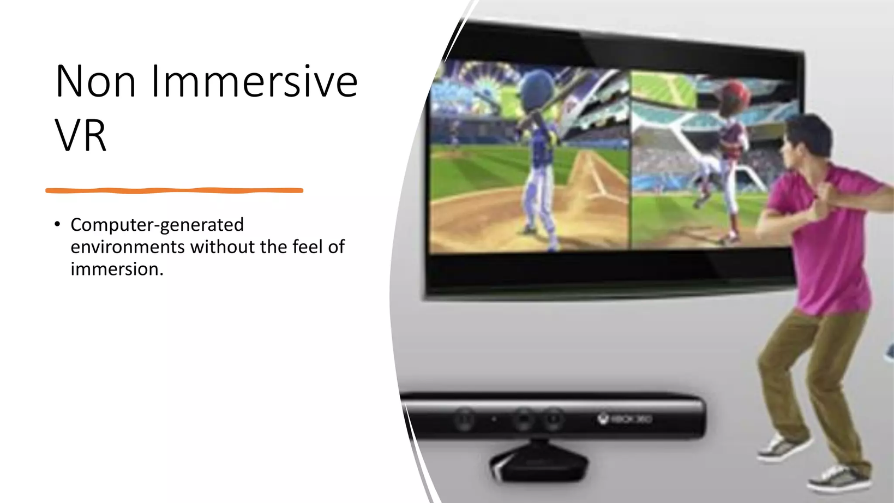
Non-immersive VR
Non-immersive virtual reality is the most basic form of virtual reality in which you act with virtual environments through some controllers and input devices but you are not a part of that particular virtual world. The virtual environment and your physical world are two separate domains interacting through just display and input devices to interact with the virtual world.

Slide 10
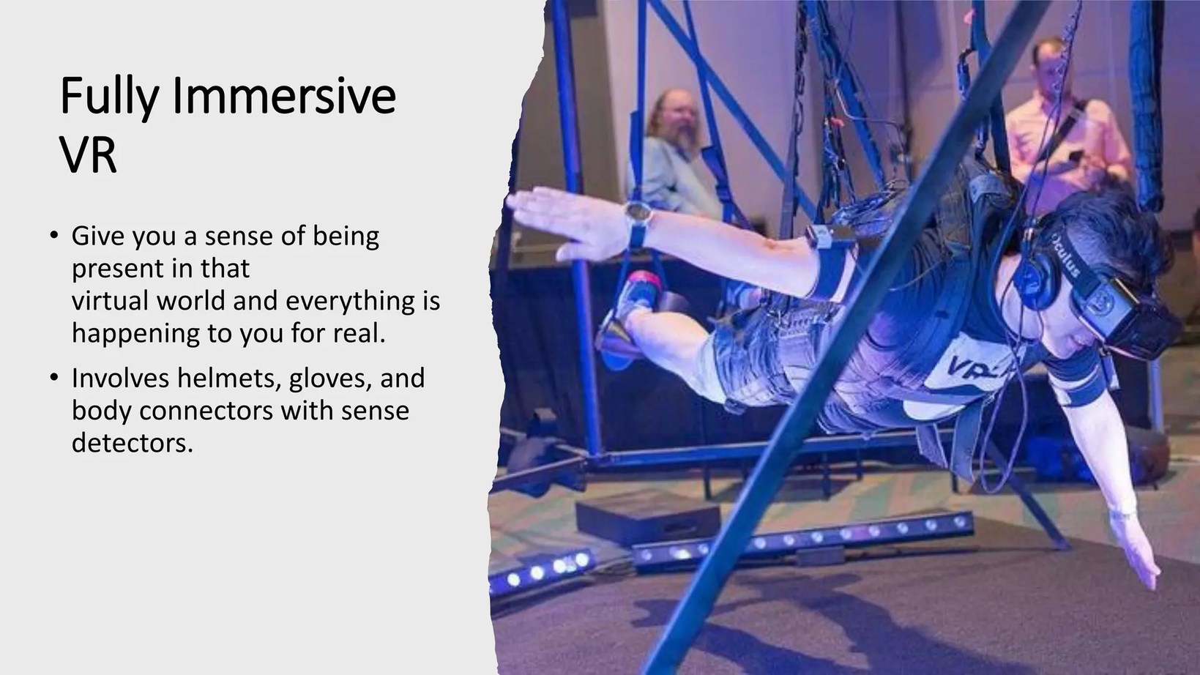
Fully-Immersive VR
This is the most powerful virtual environment in which you experience yourself in the virtual world and all interactions can be experienced in the virtual environment through multiple gadgets worn on your body. The user feels realistic presence and experience of virtual world and all activities happening in the virtual environment are focused on the user of the environment.

Slide 11
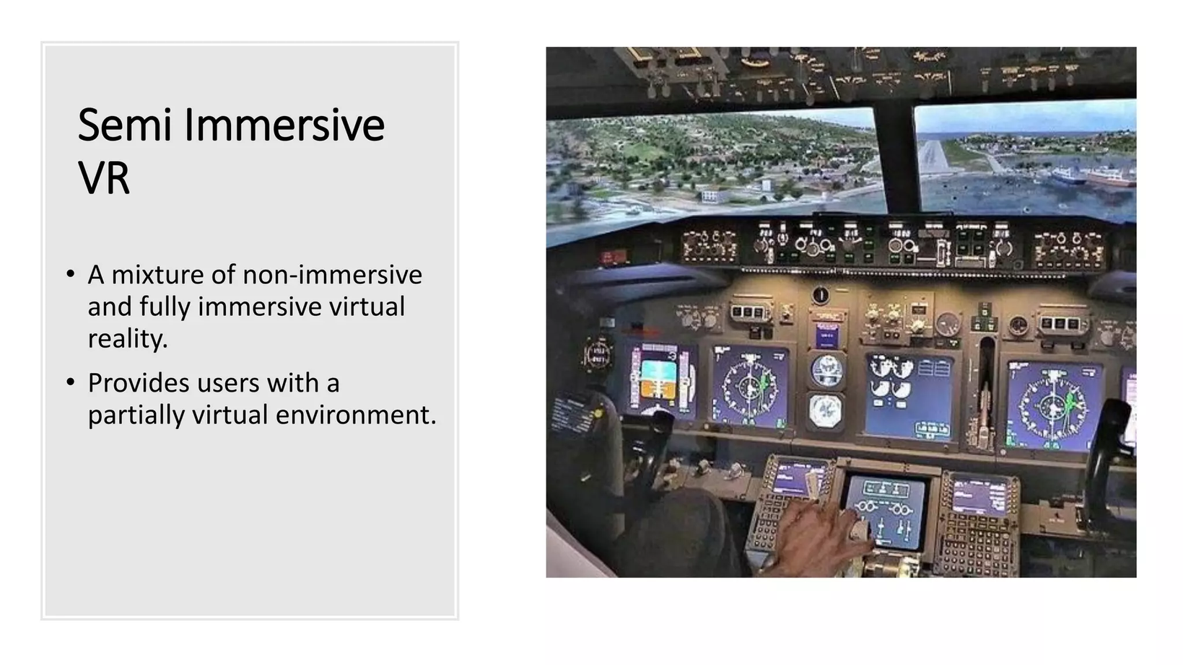
Semi-immersive VR
In this type of virtual reality environment, you interact with the environment through self-movement and other actions via computer touch screens or gamming console but not through any specific environment or tools made for the immersive experience of the user.

Slide 12
Neurophysiological Tactile Measurement Techniques
Electroencephalography (EEG)
Magnetoencephalography (MEG)
Functional Magnetic Resonance Imaging (fMRI)

Slide 13
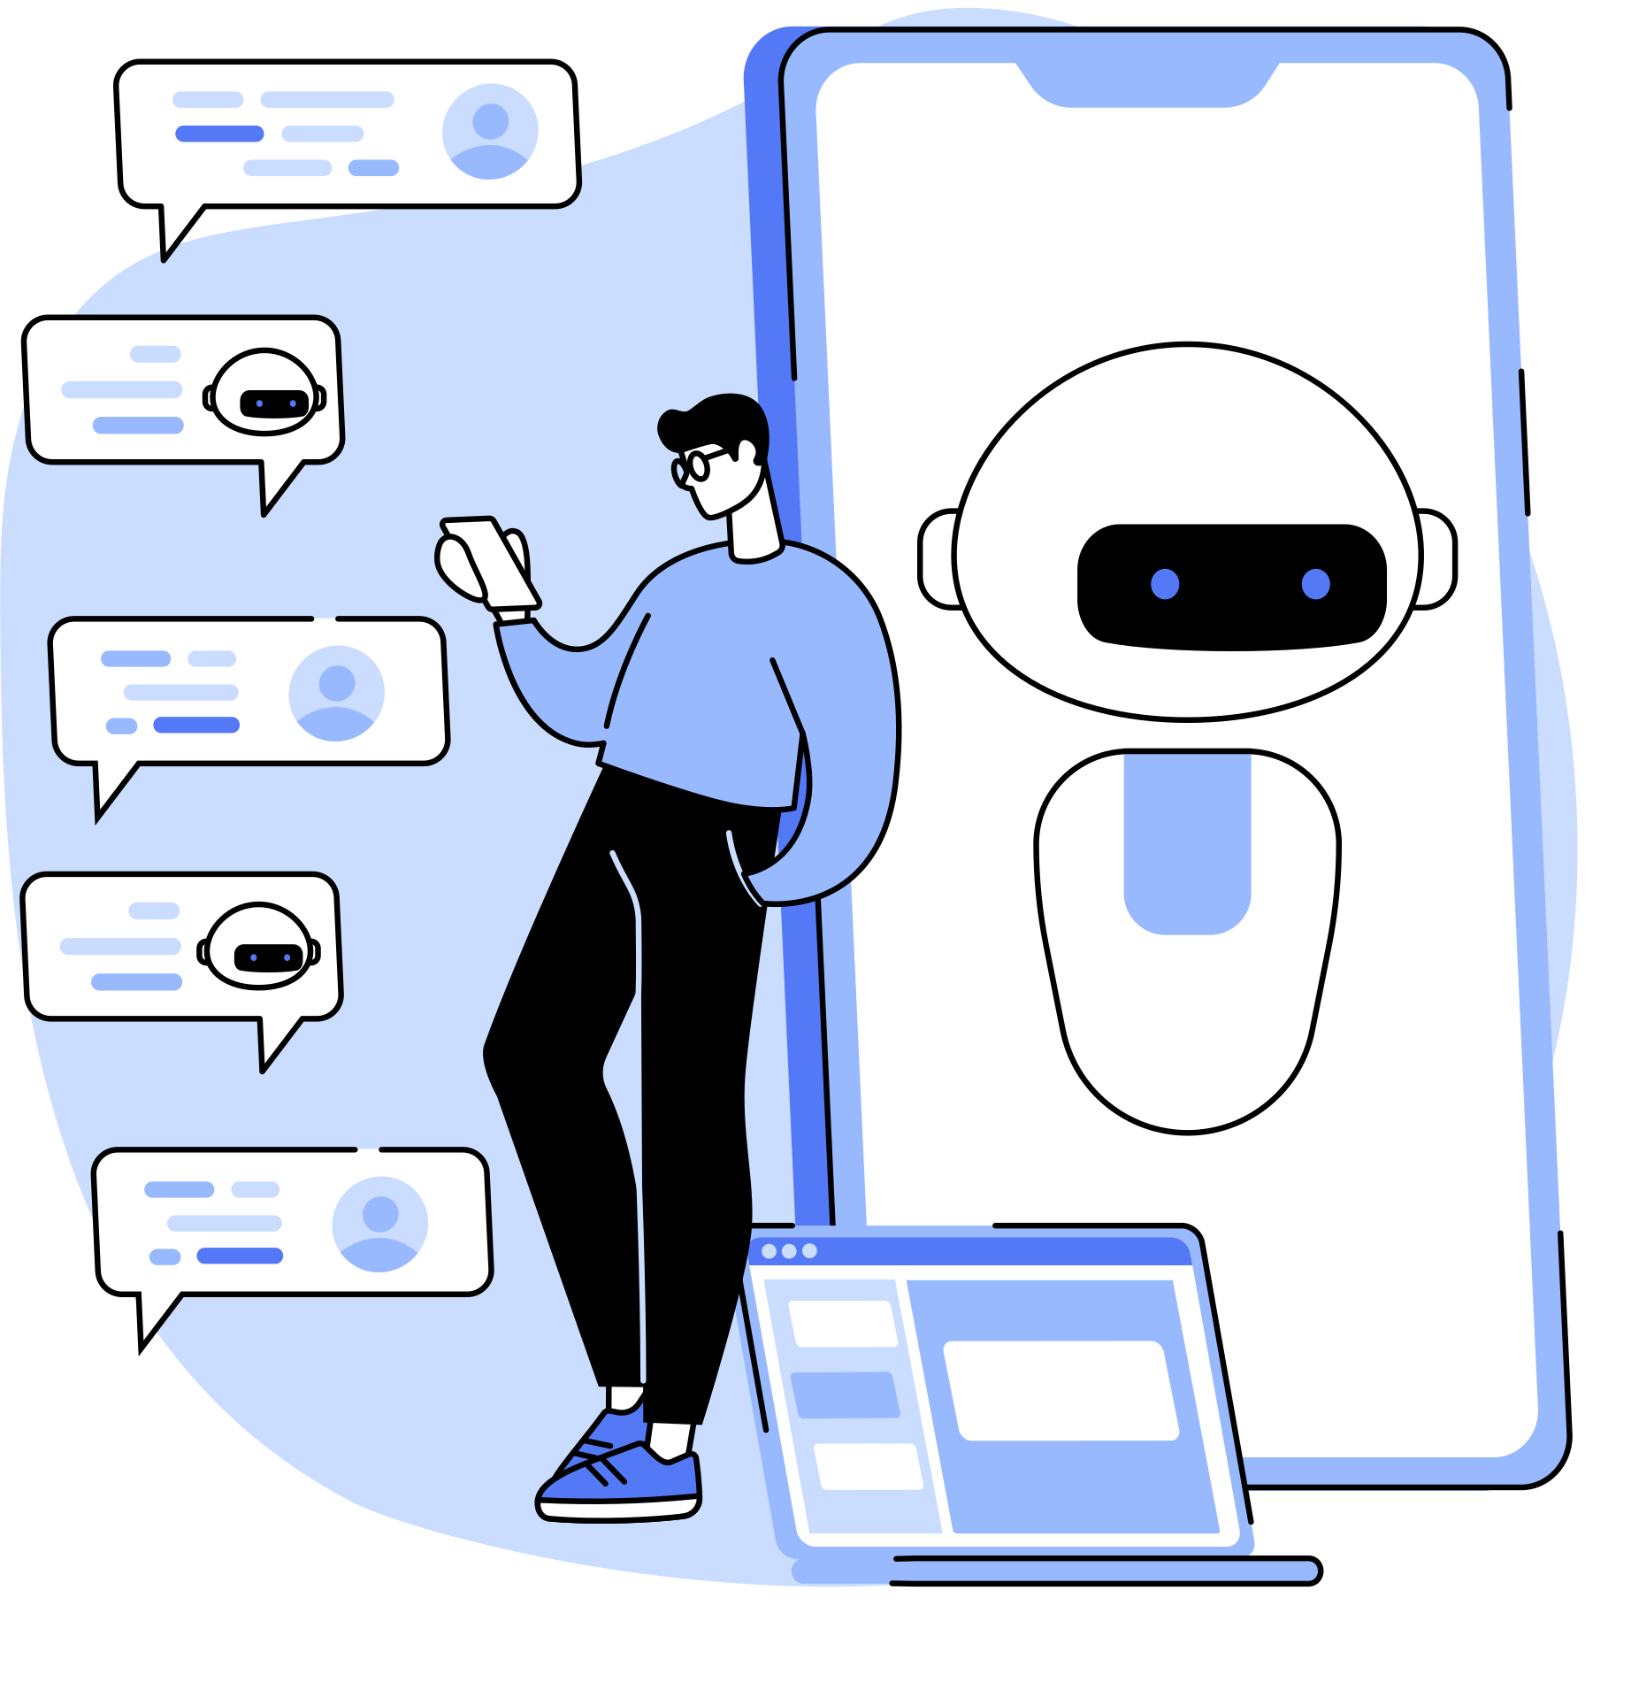
Electroencepha-lography (EEG)
Electroencephalography is a technique used to measure the brain’s spontaneous electrical activities for a certain period. This technique is extensively used in modern healthcare applications as well as modern virtual reality environment where the mental activities are also sensed and incorporated into the VR-powered environments.

Slide 14

Magnetoence- phalography (MEG)
Magnetoencephalography, precisely referred to as MEG, is a technique to measure the magnetic fields created by the electrical currents in the brain cells.

Slide 15

Functional Magnetic Resonance Imaging (fMRI)
This uses the magnetic resonance (MR) to measure the changes in the flow. The blood flow can be used to measure the brain activities. This technique can also be incorporated to build the most advanced virtual reality environments.

Slide 16

Somatosensation
Somatosensation is a type of sense, which is commonly known as the sixth sense. It pertains to a range of different sub-senses. Our brain has a neural network that deals with the perception of touches.

Slide 17
Somatosensation
Temperature sense—Thermoception
Pain—Nociception
Pressure, discriminatory touch and vibration—Mechanoreception
Balance—Equilibrioception
Movement and position—Proprioception.

Slide 18
Active somatosenation
Active somatosenation or active touch is the type of sensing that involves proprioceptive and tactile sensing under the control of movement and balance.

Slide 19
Passive somatosensation
Passive somatosensation also referred to as passive touch is a type of sense in which the stimulus of the touch is imposed on the body when the body is unaware of the stimulus as well as not in motion. It is not self-initiated.

Slide 20
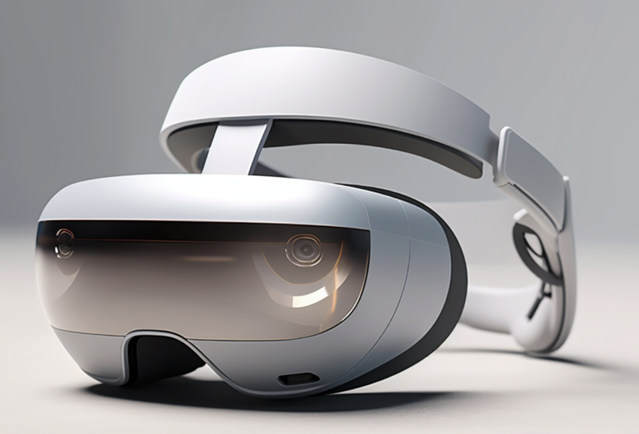
Head mounted display
Head mounted display is small optical display that is integrated into eyeglasses and mounted on helmets to put on the scalp. The display is integrated with the imaging through modified eyeglasses that form the image on the eye’s retina.

Slide 21
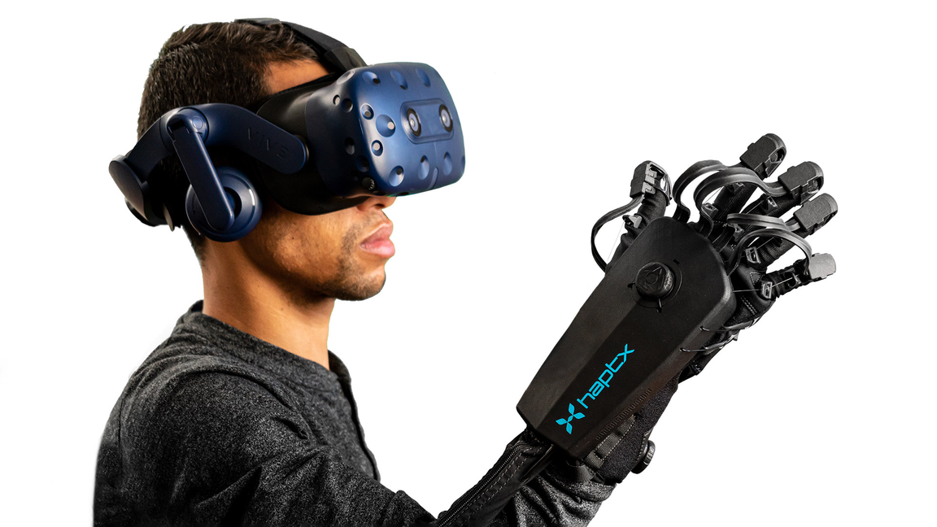
Haptics
Haptics is a term that is used in virtual reality communication extensively. It is a form of communication through touch sense or applying force in the shape of thrust, vibration, and others. It is also known as kinaesthetic communication in 3D technologies.

Slide 22
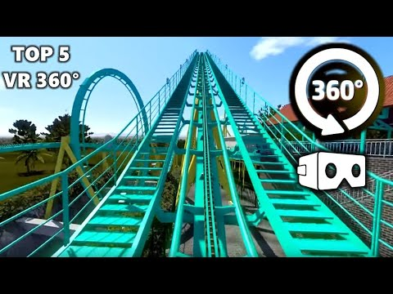
360 videos
360 videos are also known through different names such as spherical videos, surround videos, and immersive videos. These videos are recorded through omnidirectional cameras, which can record all directions of the field.

Slide 23
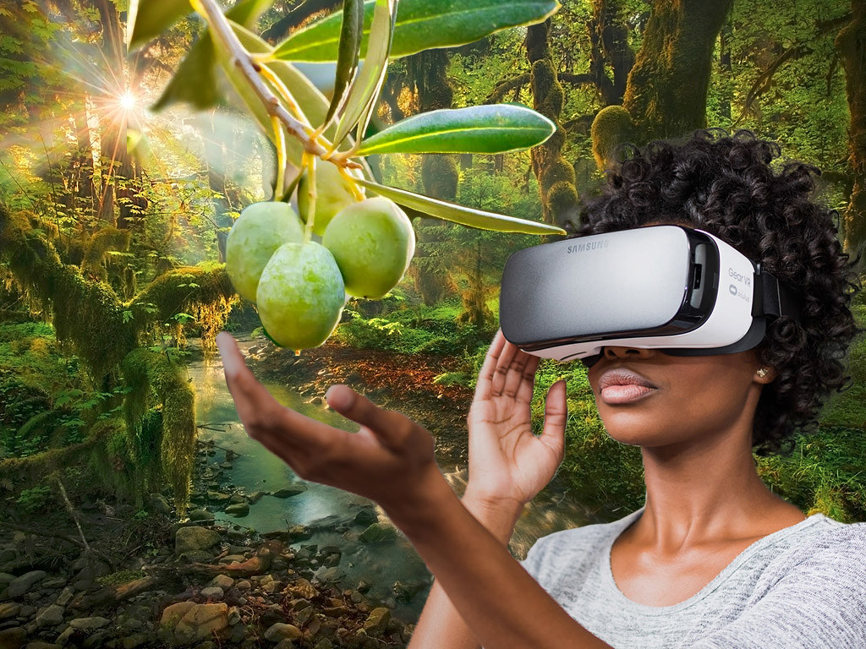
Interactive VR
Interactive virtual reality is a virtual system that allows the user to interact with the virtual environment through different types of tools such as tracking sensors, hand controller, and others. Interactive VR is also referred to as 360 VR

Slide 24
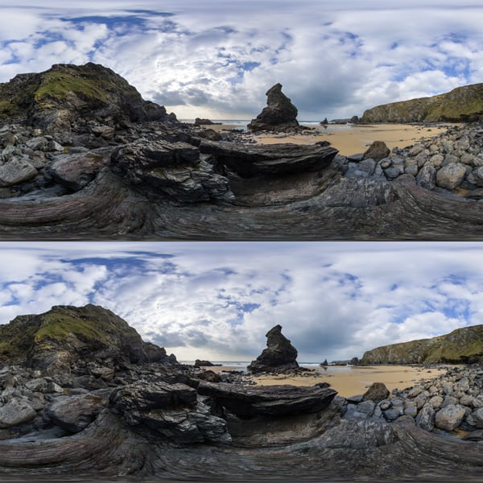
Stereoscopy
Stereoscopy is a process of enhancing the illusion of mind in an image by adding depth into the image. This is done through merger of two images to increase the depth of an image.

Slide 25
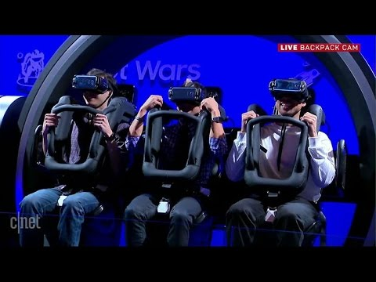
4D VR
The term 4D VR refers to the incorporation of physical world into the virtual world in modern computer-vision applications. The latest VRpowered gaming and other types of entertainment applications use the 4D VR technology to enhance the user experience in interactive gaming as well as other fields.

Slide 26
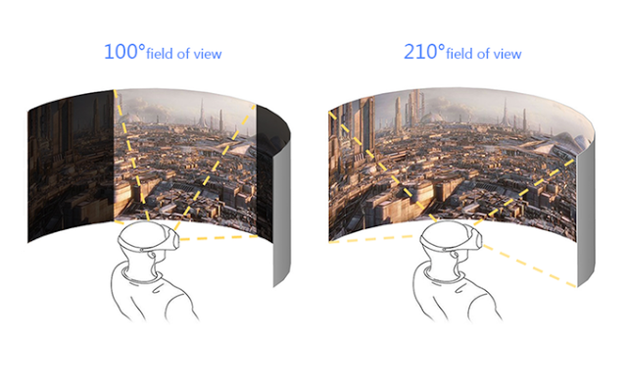
field of view
The field of view, precisely referred to as FOV in VR technology, is the observable environment or world through a single camera or an array of cameras at one single moment

Slide 27
Image/Video Stitching
Image/video stitching is a technique that is used in enhancing the ield of view (FOV) in VR-powered applications. In this process, multiple overlapping videos and images are connected or merged together to increase the field of view and improve the quality of the view simultaneously.

Slide 28
simulator sickness
The simulator sickness is the discrepancy in the motion between realworld environment and simulator environment for a simulator user that may result in vomiting, lethargy, uneasiness, headache, ocular motor disturbance, disorientation, and drowsiness

Slide 29
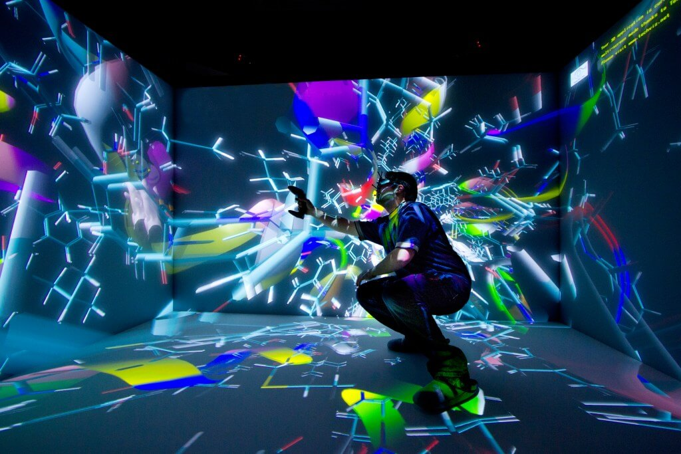
Cave Automatic Virtual Environment
Cave Automatic Virtual Environment, precisely referred to as CAVE in virtual reality field, is a fully-immersive virtual reality environment with the help of projectors. This room supports multi-person, high-fidelity audio, high definition 3D videos in an immersive virtual environment.

Slide 30
Mixed reality
Mixed reality or MR is the combination of two worlds, i.e. real world and virtual world to create a new world where both real and virtual worlds coexist. The creation of a new world combined with the real and virtual environments does not exist in any one of those worlds but they coexist in both virtual and real environments.

Slide 31
Real-Word Applications of Tactile Virtual Reality
1
Video Games
2
Education and Training
3
Product Development

Slide 32

THANK YOU FOR LISTENING!

